Slide 1

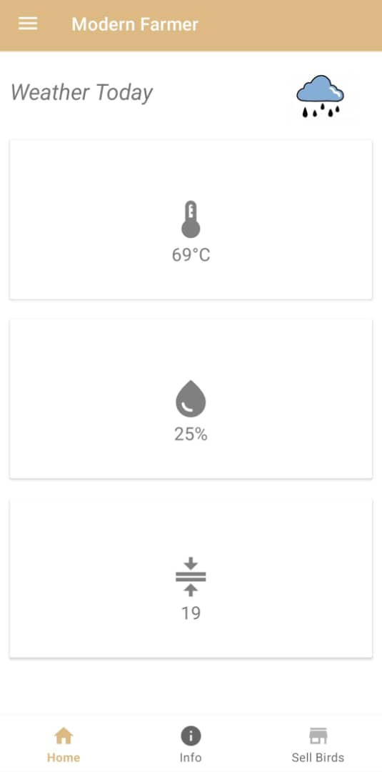
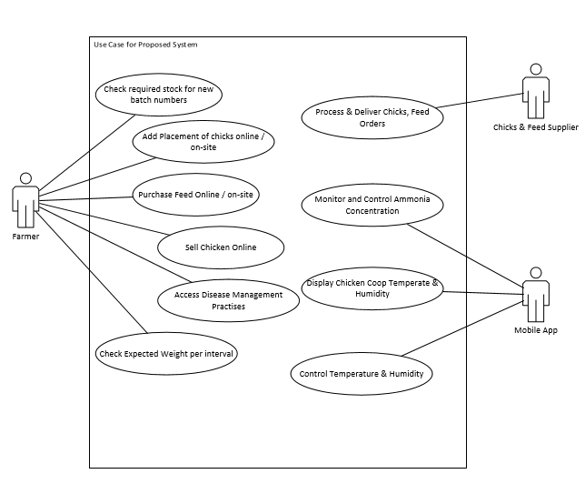
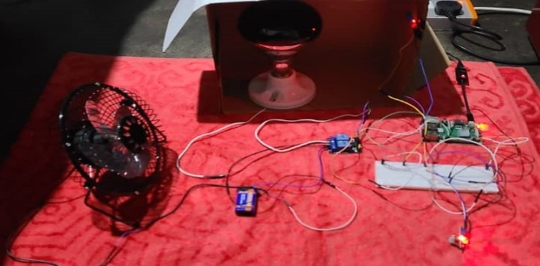
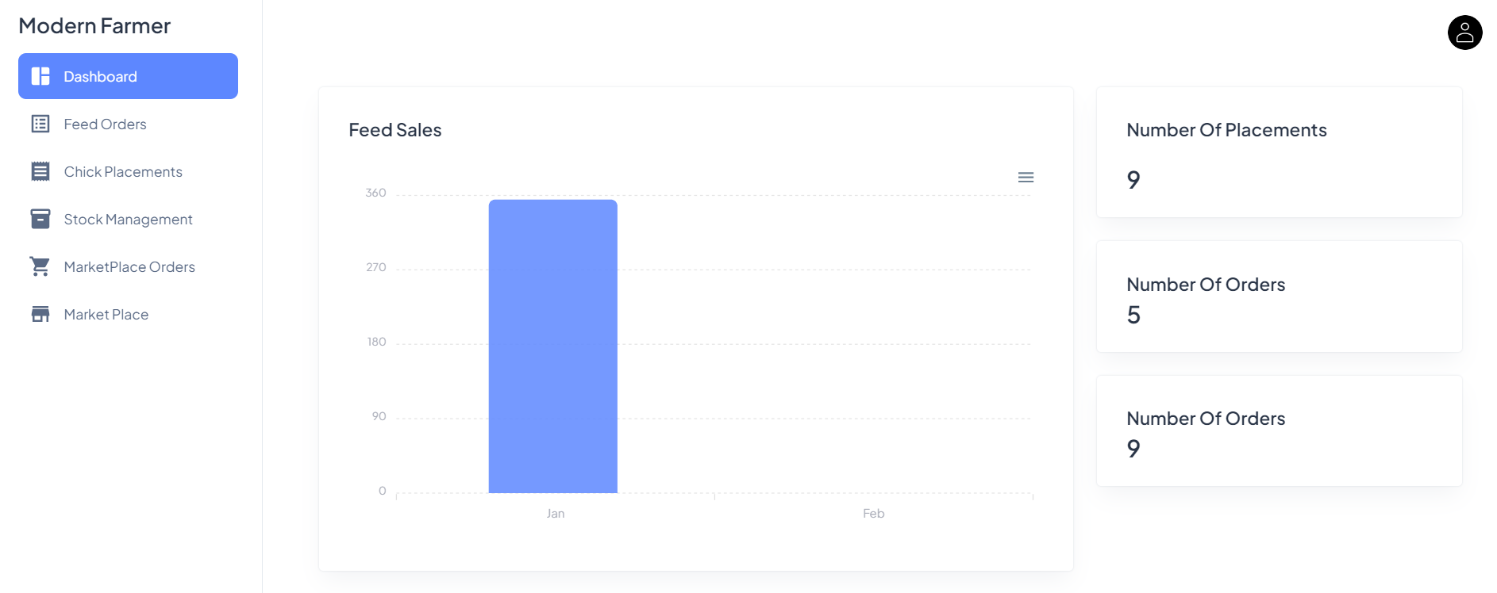
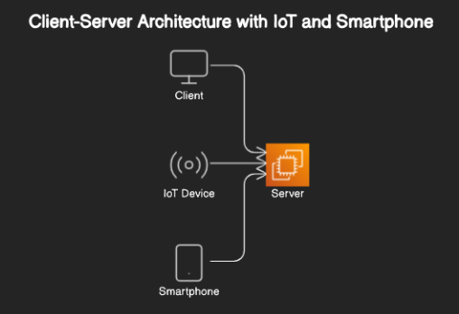
MODERN FARMER ( Android Mobile Application with IoT Integration for Modernizing Poultry Farming )
Luke Tembani Munyandu - Software Engineering Department
1.0 Abstract
3.0. Problem definition
7.0. Use Case Diagram
Zimbabwe's poultry farming sector faces challenges due to limited information access, unreliable supply chains, disease management, and market opacity, hindering local farmers' growth. To combat these issues, we propose Modern Farmer, a mobile app leveraging technology to revolutionize poultry farming. It offers real-time environmental monitoring for chicken coops through IoT, automated air regulation, and infrared lighting. Interactive features predict feed quantity and weight per chick, alongside a poultry marketplace connecting farmers with customers. Modern Farmer prioritizes offline access and secure transactions, aiming to empower farmers, optimize operations, and boost economic outcomes in Zimbabwe's poultry industry.
Poultry farming in Zimbabwe faces significant challenges including limited access to critical information, unreliable supply chains for chicks, disease management issues, and opaque market dynamics. These obstacles hinder the growth and economic prosperity of local farmers. To address these challenges, this paper aims to develop and implement innovative solutions, focusing on leveraging mobile technology through the Modern Farmer application. By providing real-time environmental data monitoring and facilitating improved access to resources and markets, the goal is to overcome the barriers hindering the poultry industry's development and enhance economic outcomes for farmers.
2.0. Introduction
4.0. Overview of the developed application
Modern Farmer is a pioneering mobile application poised to transform poultry farming practices in Zimbabwe. By leveraging modern technology, it revolutionizes every aspect of the poultry farming journey, from chick procurement to sales. The app provides indispensable insights by offering real-time environmental data tailored to individual chicken coops. With this information, farmers can make informed decisions leading to operational optimization and enhanced productivity. Modern Farmer eradicates longstanding obstacles in the poultry industry, including disease management, inventory issues, and market hurdles, by seamlessly connecting users with suppliers and resources, even in remote areas.
Poultry farming in Zimbabwe faces significant challenges including limited access to critical information, unreliable supply chains for chicks, disease management issues, and opaque market dynamics. These obstacles hinder the growth and economic prosperity of local farmers. Modern Farmer addresses these challenges by developing and implementing innovative solutions through its mobile technology platform. The app provides real-time environmental data monitoring and facilitates improved access to resources and markets, aiming to overcome the barriers hindering the poultry industry's development and enhance economic outcomes for farmers.
To ensure the well-being of the poultry and promote healthy living conditions, the app incorporates various tools and technologies. One essential component is the use of IoT devices such as Raspberry Pi, MQ135 sensors, and DTH11 & DTH22 temperature and humidity sensors. These devices work in tandem to monitor and regulate the coop environment, ensuring optimal conditions for the chickens. For instance, maintaining an appropriate temperature range between 21°C to 29°C, as recommended by experts, is crucial for the chickens' health and productivity. Modern Farmer utilizes this data to automate tasks such as adjusting air regulation and controlling infrared lighting systems, thus mitigating risks of heat and cold stress.
Existing research emphasizes the significance of providing chickens with a controlled environment to meet their thermal requirements. Various studies have explored techniques such as evaporative cooling systems and insulated roofs to regulate coop temperature effectively. However, manual intervention and reliance on electrical energy remain prevalent in many existing systems. Modern Farmer addresses these limitations by offering an automated solution that optimizes temperature control while minimizing energy consumption and maintenance costs.
In summary, Modern Farmer represents a paradigm shift in poultry farming, offering a comprehensive solution to address longstanding challenges in the industry. By integrating cutting-edge technology and innovative strategies, it empowers farmers to optimize operations, improve productivity, and navigate the complexities of poultry farming with ease.
Modern Farmer is a cutting-edge mobile app designed to revolutionize poultry farming in Zimbabwe. It enhances every aspect of poultry farming, from chick procurement to sales, by providing real-time environmental data specific to your chicken coop. This data enables farmers to make informed decisions, optimize operations, and tackle challenges such as disease, inventory management, and market access. The app connects farmers with suppliers and resources, even in remote areas, making modern poultry farming more accessible and efficient. Welcome to the future of poultry farming with Modern Farmer.
5.0. Objectives
To implement automated air regulation, adjusting based on humidity levels and air quality parameters for optimal environmental control
To develop an automated infrared lighting system that adjusts based on temperature level.
To develop an interactive system to provide real-time information on both the required feed quantity for each input batch and the expected weight per chick.
To create a poultry marketplace, connecting farmers with a broad customer base for efficient and diverse product sales.
8.0. Screenshots
Conclusion
6.0. System Overview
Modern Farmer introduces a transformative approach to poultry farming in Zimbabwe by leveraging advanced technology and mobile applications. Through comprehensive client-server architecture, the system ensures efficient data management and real-time communication between IoT devices, mobile, and web applications. Key features such as automated environmental control, infrared lighting, and an interactive marketplace empower farmers with essential tools to enhance productivity, manage resources efficiently, and expand market access. By addressing critical challenges and promoting sustainable agricultural practices, "Modern Farmer" significantly improves poultry farming operations, contributing to economic growth and food security in rural communities.
Supervisor – Ms Zndowe

